Slide 1
Yeast cloning and expression vectors

Slide 2
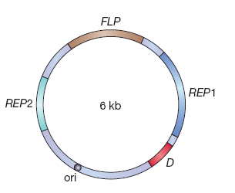
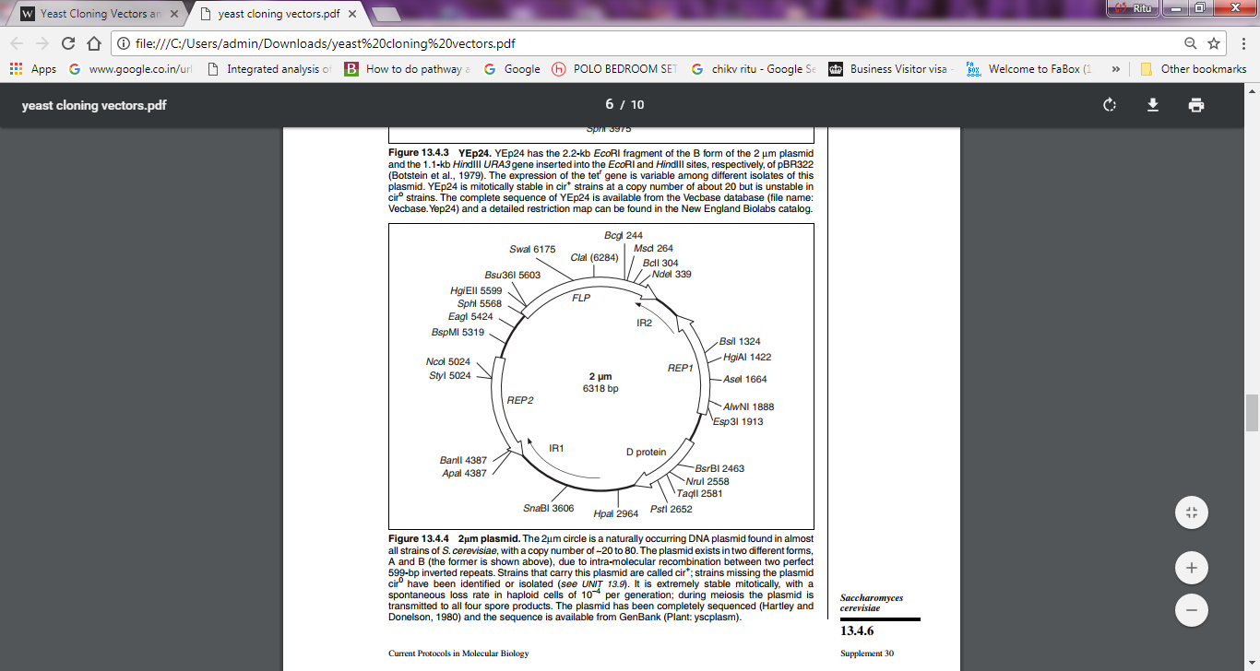
yeast 2 μm plasmid
The yeast 2 μm plasmid. REP1 and REP2 are involved in replication of the plasmid, and FLP codes for a protein that can convert the A form of the plasmid (shown here) to the B form, in which the gene order has been rearranged by intramolecular recombination. The function of D is not
exactly known.

Slide 3
Vectors based on the 2 um plasmid—
Yeast episomal plasmids
Yeast integrative plasmids
Yeast replicative plasmids

Slide 4
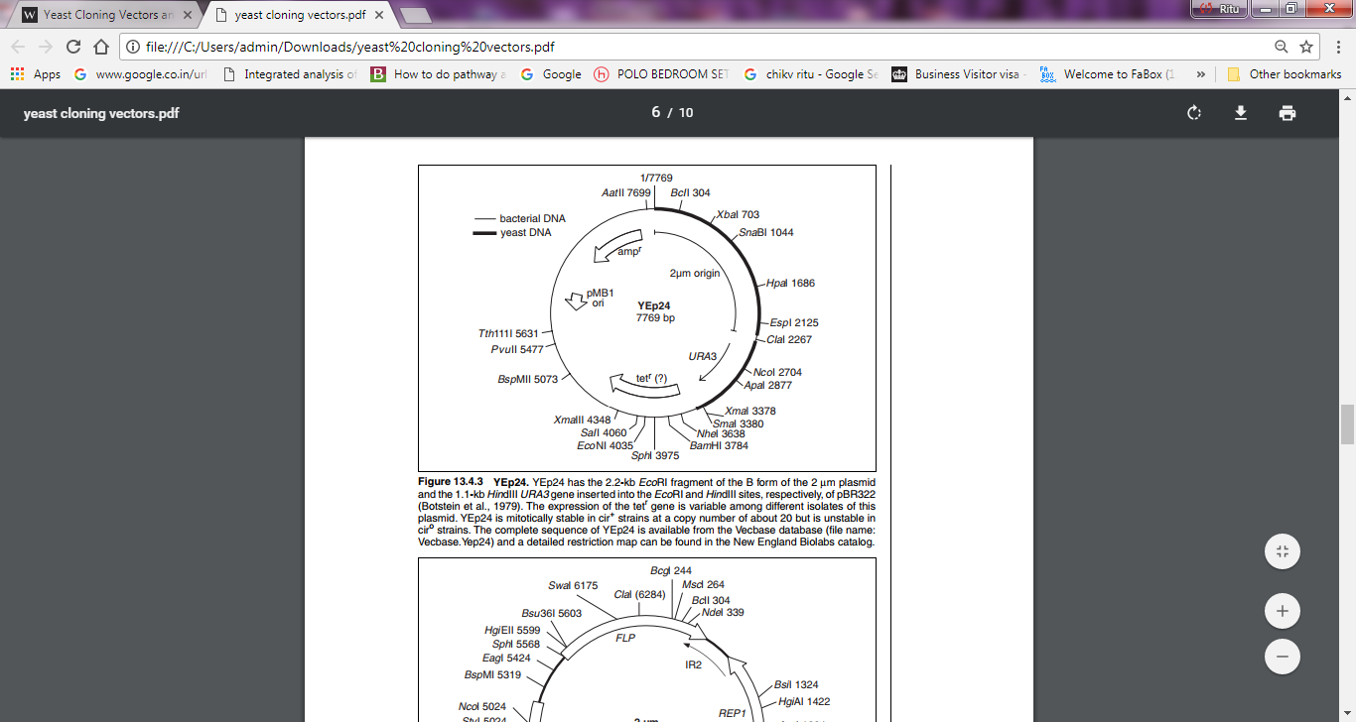
Yeast episomal plasmids

Slide 5
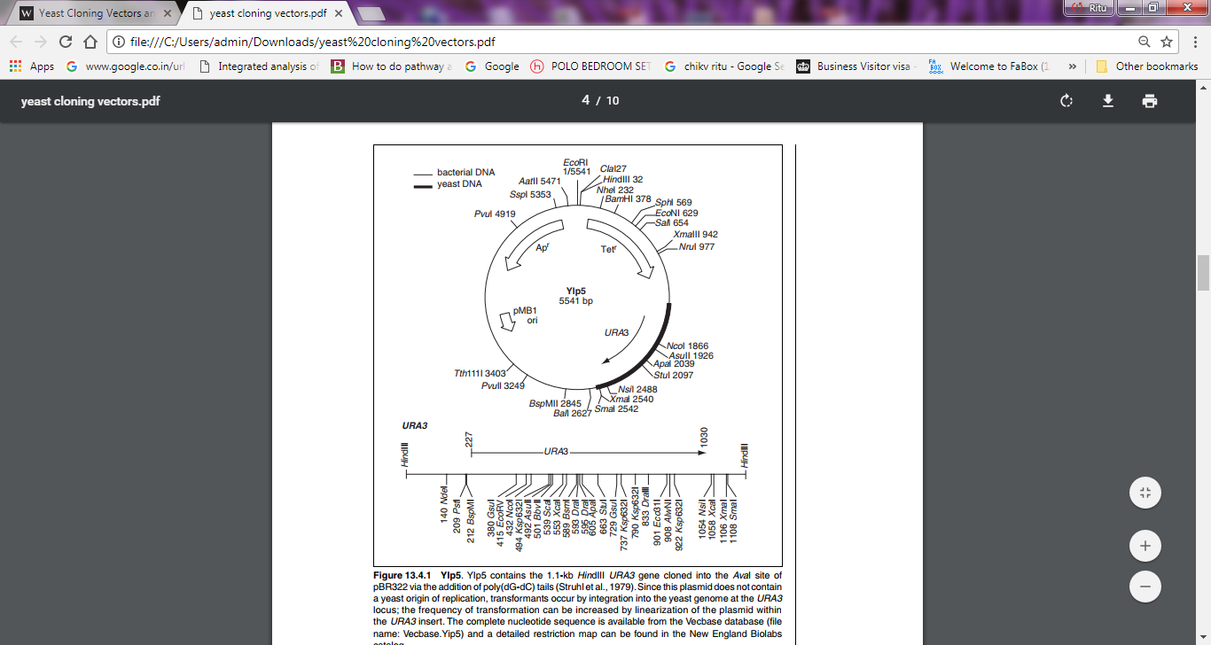
Yeast integrative plasmids
Notes:
URA3 codes for orotidine-5′-phosphate decarboxylase (an enzyme that catalyzes one of the steps in the biosynthesis pathway for pyrimidine nucleotides) and is used as a selectable marker in exactly the same way as LEU2

Slide 6
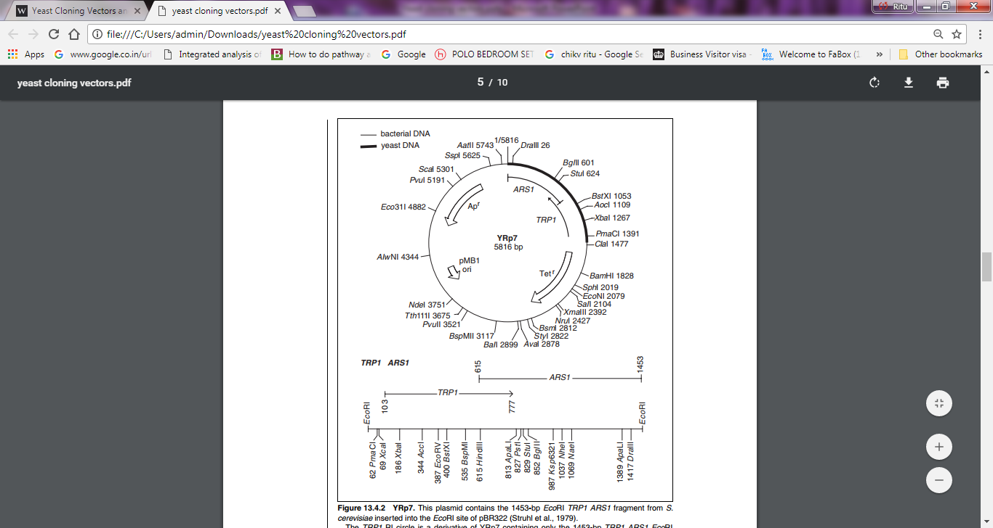
Yeast replicative plasmids
Notes:
Figure 13.4.2 YRp7. This plasmid contains the 1453-bp EcoRI TRP1 ARS1 fragment from S. cerevisiae inserted into the EcoRI site of pBR322 (Struhl et al., 1979). The TRP1 RI circle is a derivative of YRp7 containing only the 1453-bp TRP1 ARS1 EcoRI fragment. This plasmid is mitotically and meiotically unstable, but is present in 100 to 200 copies per plasmid-bearing cell in both cir+ and ciro strains. A genomic plasmid bank has been constructed by inserting size-selected Sau3A partial fragments into the BamHI site of YRp7 (Nasmyth and Reed, 1980). The TRP1 ARS1 1453-bp EcoRI fragment contains both the TRP1 gene, encoding N-(5′-phosphoribosyl)-anthranilate isomerase, and the autonomous replication sequence ARS1. The intact TRP1 gene can complement mutations in the trpC gene of E. coli, using E. coli JA300 (thr1 leuB6 thi1 thyA trpC1117 hsrk − hsmk − strr ; Tschumper and Carbon, 1982). The chromosomal replicator ARS1 lies between positions 615 and 1453 (on a HindIII-EcoRI fragment) and is composed of three domains. Domain A contains an 11-bp core sequence (position 857 to 867) consisting of a consensus sequence found in many other ARS elements and which is essential for ARS1 function. Domains B and C flank Domain A and are relatively AT-rich regions that contribute to, but are not essential, for ARS function.

Slide 7
Choice of vectors
Three factors come into play when deciding which type of yeast vector is most suitable for a particular cloning experiment.
1.Transformation frequency,
YEps> YRps>YIps
YEps have the highest transformation frequency, providing between 10,000 and 100,000 transformed cells per ug.
YRps are also quite productive, giving between 1000 and 10,000 transformants per ug,
YIp yields less than 1000 transformants per ug, and only 1–10 unless
special procedures are used.
The low transformation frequency of a YIp reflects the fact that the rather rare chromosomal integration event is necessary before the vector can be retained in a yeast cell.

Slide 8
Choice of vectors
2. Copy number.
YEps and YRps have the highest copy numbers: 20–50 and 5–100, respectively.
In contrast, a YIp is usually present at just one copy per cell. These figures are important if the objective is to obtain protein from the cloned gene, as the more copies there are of the gene the greater the expected yield of the protein product.

Slide 9
Choice of vectors
3. Stability
YIps produce very stable recombinants, as loss of a YIp that has become integrated into a chromosome occurs at only a very low frequency.
In contrast, YRp recombinants are extremely unstable, the plasmids tending to congregate in the mother cell when a daughter cell buds off, so the daughter cell is non-recombinant.
YEp recombinants suffer from similar problems,though an improved understanding of the biology of the 2 fm plasmid has enabled more stable YEps to be developed in recent years

Slide 10
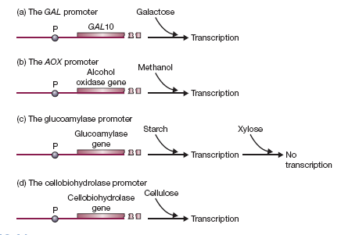
Expression in Yeast choice of promoters

Slide 11
Host Strains
Saccharomyces cerevisiae- It is currently the most popular microbial eukaryote for recombinant protein production.
(Problems- unable to glycosylate animal proteins correctly, often adding too many sugar units (“hyperglycosylation”), it also lacks an efficient system for secreting proteins into the growth medium.
Pichia Pastoris- It is able to synthesize large amounts of recombinant protein (up to 30% of the total cell protein) and its glycosylation abilities are very similar to those of animal cells.
The only significant problem with P. pastoris is that it sometimes degrades recombinant proteins before they can be purified, but this can be controlled by using special growth media.
Other yeasts that have been used for recombinant protein synthesis include Hansenula polymorpha, Yarrowia lipolytica, and Kluveromyces lactis. The last of these has the attraction that it can be grown on waste products from the food industry.

Slide 12
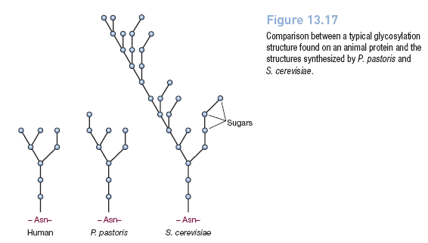
Pichia pastoris- Glycosylation

